Slide 1

Supplementary Live Session Week 6
MET CS 682
Information Systems
Analysis and Design
Dawson Williams
Updated 2/15/24

Slide 2
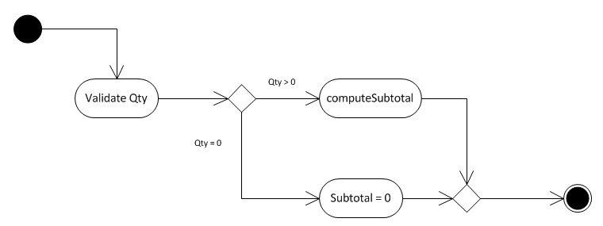
Pseudocode & Activity
Pseudo Code
IF QTY = 0
SUBTOTAL = 0
ELSE
SUBTOTAL = UNITPRICE * QTY
ENDIF
RETURN SUBTOTAL
Activity Diagram
(Jung, 2013)

Slide 3
Pseudocode Approach
Begin with the description of the algorithm in the requirements or in the detailed sequence diagram.
Introduce additional details: Writing pseudocode is flexible.
Arithmetic expressions
Verbal descriptions of operations
Express the algorithm in terms of
Sequence of operations
Loop statements, e.g., doing something while some condition is true ("while," "for," or "for each" )
Conditional statements, e.g., doing something if some condition is true ("if" or "else" )
Method calls to methods of the same or other classes

Slide 4
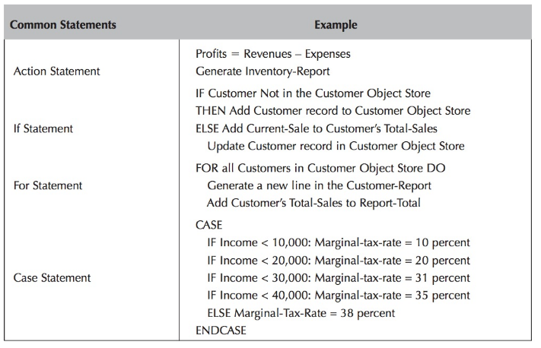
Common Statements
Figure 8-27 Page 316
Dennis, Wixom, Tegarden (2015).

Slide 5
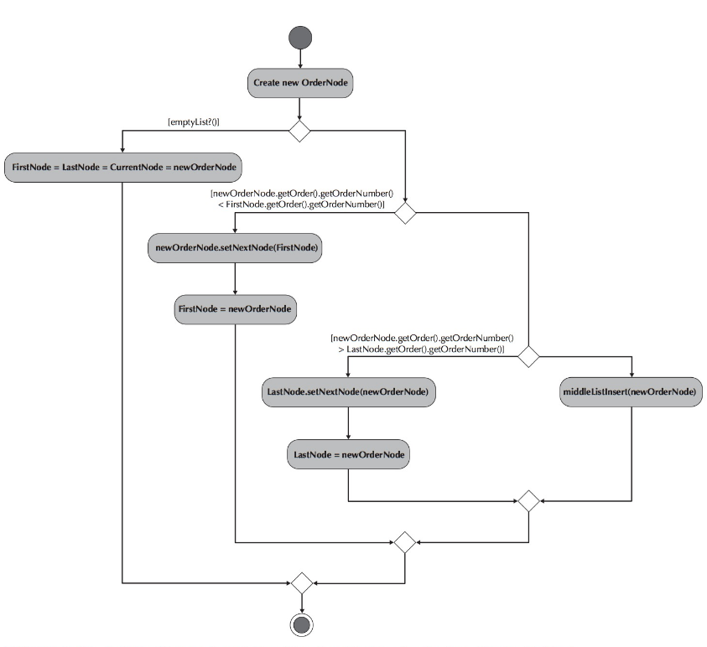
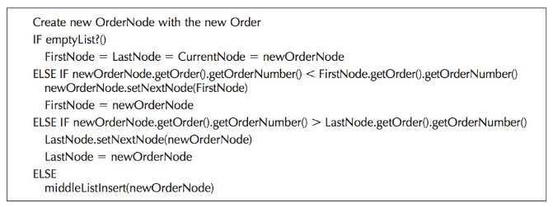
Pseudocode Example
Figure 8-30 Page 319
Dennis, Wixom, Tegarden (2015).
Figure 8-31 Page 320
Dennis, Wixom, Tegarden (2015).

Slide 6
Pseudocode - Warning, Danger Will Robinson!
Writing Pseudocode can backfire… Why? The programmer may feel that:
You are micro-managing
You are telling him/her HOW to write the code
They know more about programming than you do
You could have the Pseudocode wrong (logic)
You take away their creativity
So what is the recommendation? That you have a conversation - one that is collaborative. Also, if you are writing code, give great comments. See this website for a great taste of reality:
https://www.freecodecamp.org/news/code-comments-the-good-the-bad-and-the-ugly-be9cc65fbf83/

Slide 7
UML 2.5 Diagrams
Diagram | Description | Module Introduced
Use Case Model/Narrative (Behavior Model) | Depicts interactions between the system and external systems and users. Graphically depicts users who will use the system and in what ways the user expects to interact with the system. The use-case narrative is used in addition to a textual description of the sequence of steps of each interaction. | Module 1 and Module 3
Activity (Behavior Model) | Depicts sequential flow of activities in a use case or business process at high level, or model logic within the system at a very detailed level. | Module 1 and Module 6
State Transition and State Machine (Behavior Model) | Models how events can change the state of an object (or a system) over its lifetime, showing both the various states that an object (or system) can assume and the transitions between those states. | Module 3
Sequence (Behavior Model) | Graphically depicts how objects interact with each other via messages in the execution of a use case or operation. It illustrates how messages are sent and received between objects and in what sequence. | Module 4
Class (Structural Model) | Depicts the system's class structure. It shows the classes that the system is composed of as well as the relationships between those classes. | Module 4

Slide 8
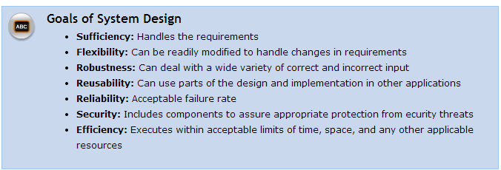

UML 2.5 Diagrams
Diagram | Description | Module Introduced
Package (Structural Model) | Depicts how classes or other UML constructs are organized into packages (corresponding to Java packages) and the dependencies of those packages. | Module 5
Data Flow (Behavior & Structural Model) | Depicts the flow of data through a system and the work or processing performed by the system. | Module 5
Network Architecture (Structural Model) | A type of physical data flow diagram that allocates processors and devices to a network showing their connectivity. | Module 5
Figure 10-9 Page 382 Whitten, B. (2007).

Slide 9
Challenges of IT Project Management
Customers are seldom sure of what they want.
It is hard to estimate up front the magnitude of the effort required.
Internal and external politics of those involved might provide incomplete or conflicting requirements and or priorities.
It is hard to coordinate requirements with corresponding design elements and code artifacts.
It is not easy to maintain constructive interpersonal team dynamics. Time pressures cause stress, and team members have differing opinions.

Slide 10
Managing the Process
Arrange an orderly means for obtaining requirements
Agree in advance on how to freeze them
Make estimates using past experience on similar projects
Use Tools
Outline Tasks & Due dates (WBS)
Outline Risks
Come up with mitigation plan
Use a clearly defined development process
Apply advice on team dynamics - Soft Skills
Balance schedule, cost, quality and functionality

Slide 11
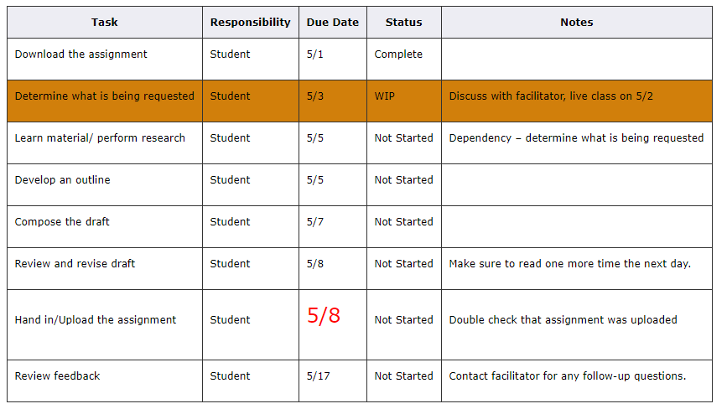
Tools-Work Breakdown Structure

Slide 12
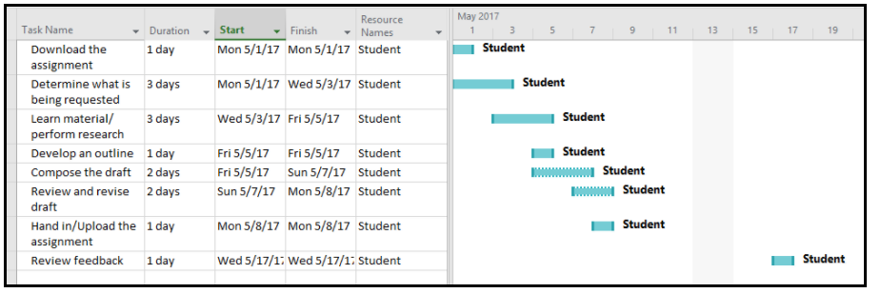
Tools-Gantt Chart
Other tools:
Google Docs
Microsoft Project
Microsoft Office
JIRA

Slide 13
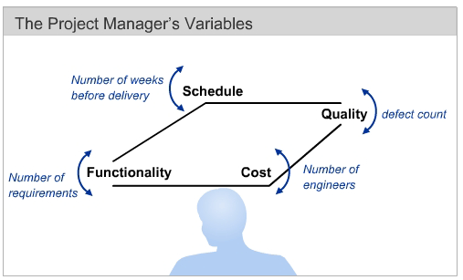
Leadership & Soft Skills
“The secret sauce is the people, not the project”
It’s people that deliver- provide the environment for them to deliver.
Communication
Listening & accepting feedback
Trust- don’t micromanage, trust skills, competencies
Ethics and doing the right thing
Internal politics awareness
Commitment - involve in decision making
Creativity & Innovation – allow for risk
Tolerance of risk and failure
Empathy & Emotional Intelligence
How to react and act fast, go with gut feeling

Slide 14
Managing Scope
Why scope may change
Users realize a particular functionality was not defined and is missing half-way through the project.
Users realize that the functionality envisioned should be different.
Unforeseen complexity with selected technology and project.
New technology is available.

Slide 15
Managing Scope Techniques
MANAGING EXPECTATIONS!!!!
Place new feature suggestion into backlog.
Use the SDLC methodology to refine scope before requirements are finalized (i.e. throwaway prototyping).
Track change and its impact, including cost (i.e. change request process).
Use smaller sprints where only specific features are worked on and the scope is focused.
Build in buffers for unforeseen requirements.
Use Timeboxing – a fixed schedule with due date. If during the timeboxed sprint it is determined that some features won’t make it in this release, postpone them to the next sprint.

Slide 16
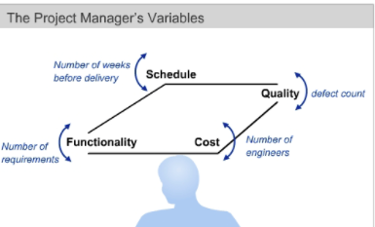
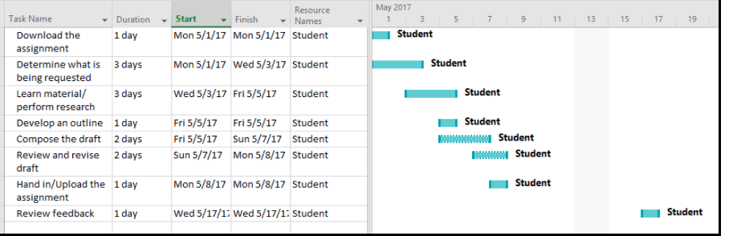
Project Estimation
How long will it take to complete a task?
How many and who are resources are needed to complete it?
How to determine due dates?
Deadline driven
Estimation of time and resources previous tasks similar in nature have taken,
Estimation in essence is an art, not just skill and experience.

Slide 17
Factors for estimation
Level of team experience with:
A similar task which was done before
Technology used
Tools used
Process
Complexity
Motivation
Maturity of technology
Can previous parts/components be re-used from a previous project?
Will the developed components need to be re-used for future projects?
What level of quality is required?

Slide 18
Factors for estimation
Usability constraints
Security constraints
Integration with other systems
Stability of requirements during the project
Team Cohesion (how well do individuals on the team work together)
Team allocation (on-site, distributed, off-shore)
Reliance on external vendors and consultants
Support of decision makers
Motivation level to deliver the system

Slide 19
Comments on Estimation
More time spent on estimation does not necessarily mean a better estimate. (Cohen, 2005)
Avoid optimistic estimates as much as possible.
If a user story or a feature is too large to estimate – disaggregate, break it into smaller parts which can be estimated.
An estimate is still an estimate, it will not be perfect because of uncertainty and that’s ok. (Cohen, 2005)
https://www.mountaingoatsoftware.com/agile/planning-poker

Slide 20
Challenges of IT Project Management
Customers are seldom sure of what they want.
It is hard to estimate up front the magnitude of the effort required.
Internal and external politics of those involved might provide incomplete or conflicting requirements and or priorities.
It is hard to coordinate requirements with corresponding design elements and code artifacts.
It is not easy to maintain constructive interpersonal team dynamics. Time pressures cause stress, and team members have differing opinions.

Slide 21
Managing the Process
Arrange an orderly means for obtaining requirements
Agree in advance on how to freeze them
Make estimates using past experience on similar projects
Use Tools
Outline Tasks & Due dates (WBS)
Outline Risks
Come up with mitigation plan
Use a clearly defined development process
Apply advice on team dynamics - Soft Skills
Balance schedule, cost, quality and functionality

Slide 22
Tools-Work Breakdown Structure

Slide 23
Tools-Gantt Chart
Other tools:
Google Docs
Microsoft Project
Microsoft Office
JIRA

Slide 24
Leadership & Soft Skills
“The secret sauce is the people, not the project”
It’s people that deliver- provide the environment for them to deliver.
Communication
Listening & accepting feedback
Trust- don’t micromanage, trust skills, competencies
Ethics and doing the right thing
Internal politics awareness
Commitment - involve in decision making
Creativity & Innovation – allow for risk
Tolerance of risk and failure
Empathy & Emotional Intelligence
How to react and act fast, go with gut feeling

Slide 25
Bring the Project Up-To-Date After Completing Detailed Design
(CS682 Module 6)
Make sure the Software Design Document reflects latest version of detailed design, after inspections
Provide details needed to complete the schedule Software Project Management Plan (WBS)
Allocate precise tasks to team members (WBS)
Improve project cost and time estimates (Design elements are now known!)
Update the Software Configuration Management Plan to reflect the new parts
(Check out Jira www.atlassian.com/software/jira) , Software Versioning Systems)
Team Review process by which the detailed design was created, and determine improvements (for next version, iteration, sprint).
Time taken; broken down to include:
Preparation of the designs
Inspection & Change
Defect summary
Number remaining open, found at detailed design, closed at detailed design
Where injected, include previous phases and detailed design stage

Slide 26
Managing Scope
Why scope may change
Users realize a particular functionality was not defined and is missing half-way through the project.
Users realize that the functionality envisioned should be different.
Unforeseen complexity with selected technology and project.
New technology is available.

Slide 27
Managing Scope Techniques
MANAGING EXPECTATIONS!!!!
Place new feature suggestion into backlog.
Use the SDLC methodology to refine scope before requirements are finalized (i.e. throwaway prototyping).
Track change and its impact, including cost (i.e. change request process).
Use smaller sprints where only specific features are worked on and the scope is focused.
Build in buffers for unforeseen requirements.
Use Timeboxing – a fixed schedule with due date. If during the timeboxed sprint it is determined that some features won’t make it in this release, postpone them to the next sprint.

Slide 28
Project Estimation
How long will it take to complete a task?
How many and who are resources are needed to complete it?
How to determine due dates?
Deadline driven
Estimation of time and resources previous tasks similar in nature have taken,
Estimation in essence is an art, not just skill and experience.

Slide 29
Factors for estimation
Level of team experience with:
A similar task which was done before
Technology used
Tools used
Process
Complexity
Motivation
Maturity of technology
Can previous parts/components be re-used from a previous project?
Will the developed components need to be re-used for future projects?
What level of quality is required?

Slide 30
Factors for estimation
Usability constraints
Security constraints
Integration with other systems
Stability of requirements during the project
Team Cohesion (how well do individuals on the team work together)
Team allocation (on-site, distributed, off-shore)
Reliance on external vendors and consultants
Support of decision makers
Motivation level to deliver the system

Slide 31
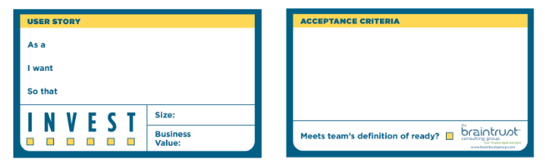
Agile Estimation – User Stories
Independent of another story, so that it can be considered and prioritized separately.
Negotiable – allow for conversation and discussion
Valuable – has functional or non-functional value to stakeholders.
Estimable – “done” team has to understand scope and complexity.
Small – within a single sprint or even less (3-4 days).
Testable –agreement on how it should be tested
http://agileforall.com/new-to-agile-invest-in-good-user-stories/
https://www.braintrustgroup.com/product/user-story-cards/

Slide 32
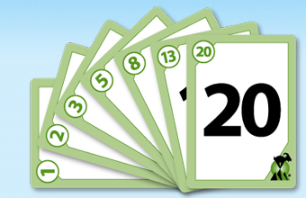
Agile Estimation
Planning Poker – consensus based estimation
MountainGoatSoftware.com Mike Cohn
Product Owner reads user story/features to cross-functional team of estimators from backlog.
Each Estimator has a Planning Poker Deck of 0,1,2,3,5,8,13,20,40,100
Values represent the number of story points, ideal days, or other units in which the team estimates (experience).
Expert Opinion/Analogy/Disaggregation
Discussion/Questions – value card selected by each estimator
All cards revealed.
If same value is selected, it becomes estimate otherwise high and low values are discussed and estimates are re-selected until consensus is reached.
https://www.mountaingoatsoftware.com/agile/planning-poker

Slide 33
Agile Estimation
Conduct once per iteration at the start of the sprint.
Cross functional agile teams are part of the estimation and discussion process.
Justification of estimates helps uncover missing information.
Pros/Cons of establishing a common baseline
Distributed teams?
https://www.mountaingoatsoftware.com/agile/planning-poker

Slide 34
Comments on Estimation
More time spent on estimation does not necessarily mean a better estimate. (Cohen, 2005)
Avoid optimistic estimates as much as possible.
If a user story or a feature is too large to estimate – disaggregate, break it into smaller parts which can be estimated.
An estimate is still an estimate, it will not be perfect because of uncertainty and that’s ok. (Cohen, 2005)
https://www.mountaingoatsoftware.com/agile/planning-poker

Slide 35
References
Braude, E. (2014). Module 6 IT Systems & Introduction to Process. Metropolitan College, Boston University, Boston, MA.
Whitten, B. (2007). Systems analysis & design methods. (7th ed.). New York, NY: McGraw-Hill Irwin
Dennis, A., Wixom, B. H., & Tegarden, D. (2015). Systems Analysis & Design An Object-Oriented Approach with UML (5th ed.). Wiley.
Jung Ormerod’s CS682 Week 6 slides
Alex Elentukh’s BU PMP conference discussion 2016
Cocomo® ii. (n.d.). Retrieved from http://csse.usc.edu/csse/research/COCOMOII/cocomo_main.html
https://www.mountaingoatsoftware.com
http://agileforall.com/new-to-agile-invest-in-good-user-stories/
https://www.braintrustgroup.com/product/user-story-cards/
http://www.agileadvice.com/2015/04/15/referenceinformation/summary-of-user-stories-the-three-cs-and-invest/

